Slide 1
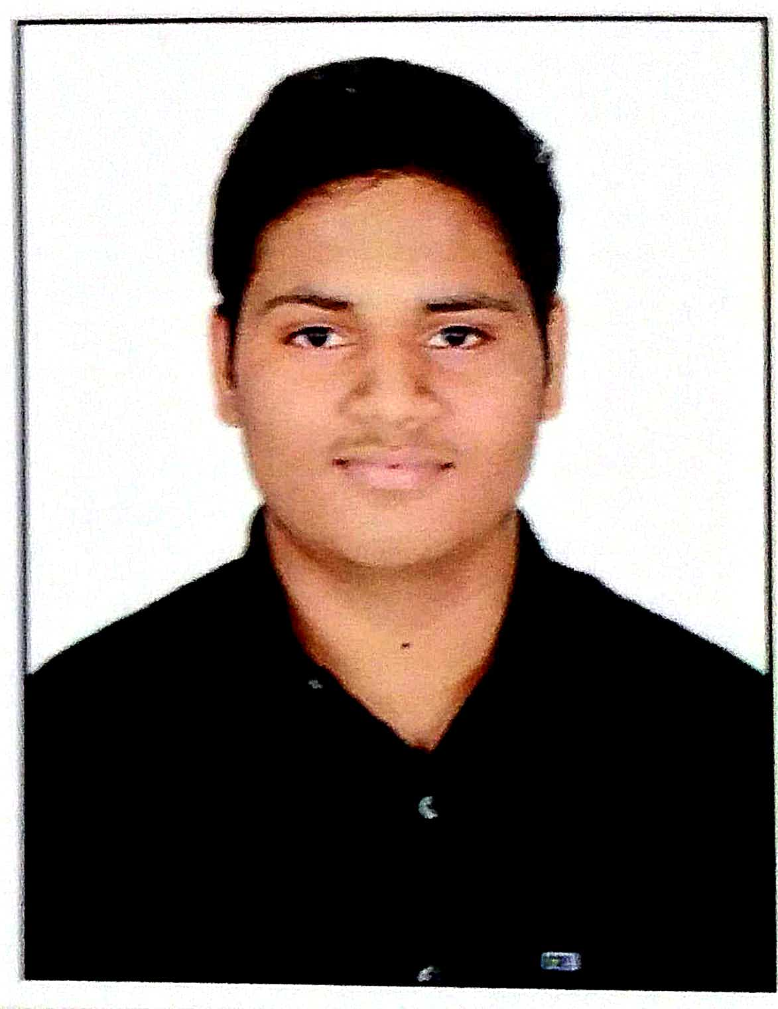
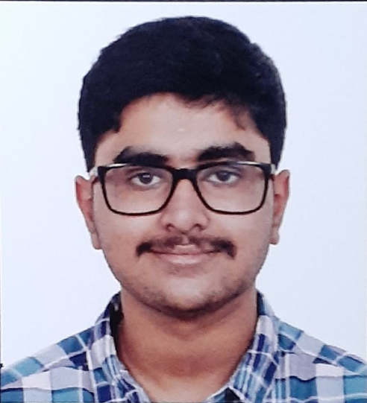
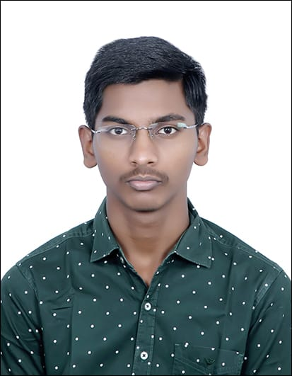
Smart Stack
Appian AIgnite Hackathon 2025 Round 2
Dip Rajhans
Jadhav, IITM, ME24B024
Adithya Rajagopalan, IITM, ME24B002
Harish Kumar US, IITM, ME24B022

Slide 2
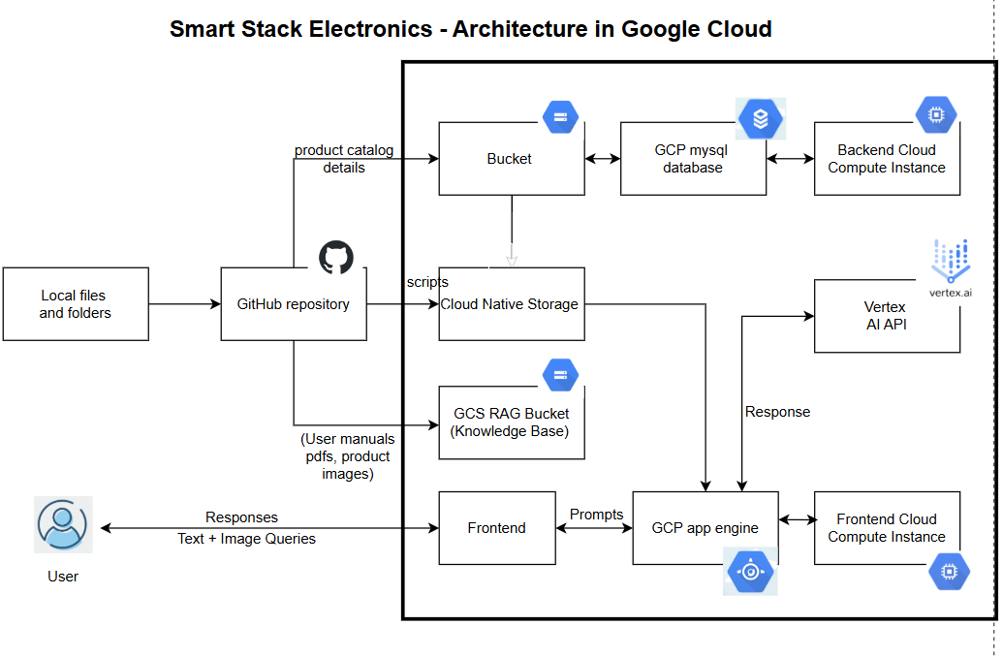

Slide 3
Project Files
Tech Aspect | Resource/Tool used
SmartStack_Blueprint | PPT to provide overview of components , architecture, artifacts and team
Demo video file | https://github.com/AdithyaRajagopalan2024/smart-stack-store-appian-round2
GitHub Repository | https://github.com/AdithyaRajagopalan2024/smart-stack-store-appian-round2

Slide 4
Tech Stack:
Tech Aspect | Resource/Tool used
Image Inputs / NLP Interactions | Google Gemini
Databases | Mysql in Google cloud platform
AI/GenAI Recommendations | Vertex AI
Frontend Development | HTML, CSS, React
Backend/ | Nodejs
Cloud Services | GCP Bucket GCP Compute Instance GCP Firewall

Slide 5
Artifacts:
Artifact Used | Purpose
app.yaml | Store all data for configuration.
env_vars.env | Store all environment and cloud configuration variables.
app.tsx | Storefront for users to access the website and interact with AI chatbot.
app.js | Backend code to carry out Vertex, GCP Bucket, Google Cloud SQL API calls and AI interactions.
index.html | Chat interface for Gemini API.
package.json | Store all necessary details to install packages on a fresh run.
tsconfig.json | Specify root files and compiler options to run the project.
Google Cloud SQL (product_Catalog.json) | Store product catalog (Product name, brand, price, etc).
Google Cloud RAG Bucket (Laptop_Pro_15.jpg, 4K_LED_TV_55.pdf, etc) | Store knowledge articles (User Manuals, Product images, Product guides).

Slide 6
Thank you!

